Slide 1

UNIVERSITY INSTITUTE OF ENGINEERING
DEPARTMENT OF AIT - CSE
Bachelor of Engineering (CSE)
Security and Data Privacy Laws and Standards (21CSF-433)
By: Ms. Merry K.P(E12903)
Assistant Professor
AIT CSE
Lecture -5
Sensitive data, Inference
DISCOVER . LEARN . EMPOWER

Slide 2
Chapter | Course Objectives
1. | Exhibit knowledge to secure corrupted systems, protect personal data, and secure computer networks in an organization.
Chapter | Course Outcomes
1. | After completion of this course, the student will be able to Know how to secure corrupted systems. Aware of personal data protection and secured networking.

Slide 3
Contents
1.1 Designing Trusted Operating Systems
Sensitive data, Inference

Slide 4
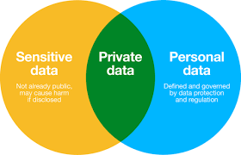
Sensitive Data
Sensitive Data are the data that should not be made public. Determining which data items and fields are sensitive depends on the individual database and the underlying meaning of the data.
For example, a student database might contain Student Name, Gender, Contact Information, Medical History, financial aid, etc. In these particular fields, contact information & medical history are non-disclosable.

Slide 5
Sensitive Data
Some databases contain what is called sensitive data. As a working definition, let us say that sensitive data are data that should not be made public.
Determining which data items and fields are sensitive depends both on the individual database and the underlying meaning of the data.
Obviously, some databases, such as a public library catalog, contain no sensitive data; other databases, such as defense-related ones, are totally sensitive.
These two cases nothing sensitive and everything sensitive are the easiest to handle because they can be covered by access controls to the database as a whole.
Someone either is or is not an authorized user. These controls are provided by the operating system.

Slide 6
Several Factors can make data sensitive.
Inherently sensitive. The value itself may be so revealing that it is sensitive. Examples are the locations of defensive missiles or the median income of barbers in a town with only one barber.
From a sensitive source. The source of the data may indicate a need for confidentiality. An example is information from an informer whose identity would be compromised if the information were disclosed.
Declared sensitive. The database administrator or the owner of the data may have declared the data to be sensitive. Examples are classified military data or the name of the anonymous donor of a piece of art.
Part of a sensitive attribute or a sensitive record. In a database, an entire attribute or record may be classified as sensitive. Examples are the salary attribute of a personnel database or a record describing a secret space mission.
Sensitive in relation to previously disclosed information. Some data become sensitive in the presence of other data. For example, the longitude coordinate of a secret gold mine reveals little, but the longitude coordinate in conjunction with the latitude coordinate pinpoints the mine.

Slide 7
Access Decisions
Remember that a database administrator is a person who decides what data should be in the database and who should have access to it.
The database administrator considers the need for different users to know certain information and decides who should have what access. Decisions of the database administrator are based on an access policy.
The database manager or DBMS is a program that operates on the database and auxiliary control information to implement the decisions of the access policy. We say that the database manager decides to permit user x to access data y.
Clearly, a program or machine cannot decide anything; it is more precise to say that the program performs the instructions by which x accesses y as a way of implementing the policy established by the database administrator. (Now you see why we use the simpler wording.)
To keep explanations concise, we occasionally describe programs as if they can carry out human thought processes.

Slide 8
Access Decisions
The DBMS may consider several factors when deciding whether to permit an access. These factors include availability of the data, acceptability of the access, and authenticity of the user. We expand on these three factors below.
Availability of Data
One or more required elements may be inaccessible. For example, if a user is updating several fields, other users' accesses to those fields must be blocked temporarily. This blocking ensures that users do not receive inaccurate information, such as a new street address with an old city and state, or a new code component with old documentation.
Blocking is usually temporary. When performing an update, a user may have to block access to several fields or several records to ensure the consistency of data for others.

Slide 9
Cont…
Acceptability of Access
One or more values of the record may be sensitive and not accessible by the general user. A DBMS should not release sensitive data to unauthorized individuals.
Deciding what is sensitive, however, is not as simple as it sounds, because the fields may not be directly requested. A user may have asked for certain records that contain sensitive data, but the user's purpose may have been only to project the values from particular fields that are not sensitive.
For example, a user of the database may request the NAME and DORM of any student for whom FINES is not 0. The exact value of the sensitive field FINES is not disclosed, although "not 0" is a partial disclosure. Even when a sensitive value is not explicitly given, the database manager may deny access on the grounds that it reveals information the user is not authorized to have.
Alternatively, the user may want to derive a nonsensitive statistic from the sensitive data; for example, if the average financial aid value does not reveal any individual's financial aid value, the database management system can safely return the average. However, the average of one data value discloses that value.

Slide 10
Cont…
Assurance of Authenticity
Certain characteristics of the user external to the database may also be considered when permitting access.
For example, to enhance security, the database administrator may permit someone to access the database only at certain times, such as during working hours.
Previous user requests may also be taken into account; repeated requests for the same data or requests that exhaust a certain category of information may be used to find out all elements in a set when a direct query is not allowed.
As we shall see, sensitive data can sometimes be revealed by combined results from several less sensitive queries.

Slide 11
Types of Disclosures
Data can be sensitive, but so can their characteristics. In this section, we see that even descriptive information about data (such as their existence or whether they have an element that is zero) is a form of disclosure.
Exact Data
The most serious disclosure is the exact value of a sensitive data item itself. The user may know that sensitive data are being requested, or the user may request general data without knowing that some of it is sensitive. A faulty database manager may even deliver sensitive data by accident, without the user's having requested it. In all of these cases the result is the same: The security of the sensitive data has been breached.

Slide 12
Cont…
Bounds
Another exposure is disclosing bounds on a sensitive value; that is, indicating that a sensitive value, y, is between two values, L and H.
Sometimes, by using a narrowing technique not unlike the binary search, the user may first determine that L y H and then see whether L y H/2, and so forth, thereby permitting the user to determine y to any desired precision.
In another case, merely revealing that a value such as the athletic scholarship budget or the number of CIA agents exceeds a certain amount may be a serious breach of security.
Sometimes, however, bounds are a useful way to present sensitive data. It is common to release upper and lower bounds for data without identifying the specific records.
For example, a company may announce that its salaries for programmers range from $50,000 to $82,000. If you are a programmer earning $79,700, you can presume that you are fairly well off, so you have the information you want; however, the announcement does not disclose who are the highest- and lowest-paid programmers.

Slide 13
Cont…
Negative Result
Sometimes we can word a query to determine a negative result. That is, we can learn that z is not the value of y.
For example, knowing that 0 is not the total number of felony convictions for a person reveals that the person was convicted of a felony.
The distinction between 1 and 2 or 46 and 47 felonies is not as sensitive as the distinction between 0 and 1. Therefore, disclosing that a value is not 0 can be a significant disclosure.
Similarly, if a student does not appear on the honors list, you can infer that the person's grade point average is below 3.50.
This information is not too revealing, however, because the range of grade point averages from 0.0 to 3.49 is rather wide.

Slide 14
Cont…
Existence
In some cases, the existence of data is itself a sensitive piece of data, regardless of the actual value.
For example, an employer may not want employees to know that their use of long distance telephone lines is being monitored.
In this case, discovering a LONG DISTANCE field in a personnel file would reveal sensitive data.

Slide 15
Cont…
Probable Value
Finally, it may be possible to determine the probability that a certain element has a certain value. To see how, suppose you want to find out whether the president of the United States is registered in the Tory party. Knowing that the president is in the database, you submit two queries to the database:
How many people have 1600 Pennsylvania Avenue as their official residence? (Response: 4)
How many people have 1600 Pennsylvania Avenue as their official residence and have YES as the value of TORY? (Response: 1)
From these queries you conclude there is a 25 percent likelihood that the president is a registered Tory.

Slide 16
Inference
Inference is a way to infer or derive sensitive data from non-sensitive data. The inference problem is a subtle vulnerability in database security.
The database in Table below can help illustrate the inference problem.
Recall that AID is the amount of financial aid a student is receiving. FINES is the amount of parking fines still owed. DRUGS is the result of a drug-use survey: 0 means never used and 3 means frequent user. Obviously this information should be kept confidential. We assume that AID, FINES, and DRUGS are sensitive fields, although only when the values are related to a specific individual. In this section, we look at ways to determine sensitive data values from the database.

Slide 17
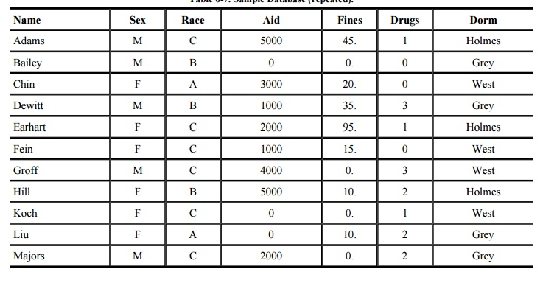
Table

Slide 18

Direct Attack
In a direct attack, a user tries to determine values of sensitive fields by seeking them directly with queries that yield few records. The most successful technique is to form a query so specific that it matches exactly one data item.
In Table above, a sensitive query might be
This query discloses that for record ADAMS, DRUGS=1. However, it is an obvious attack because it selects people for whom DRUGS=1, and the DBMS might reject the query because it selects records for a specific value of the sensitive attribute DRUGS.

Slide 19
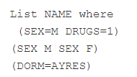
Direct Attack
A less obvious query is
On the surface, this query looks as if it should conceal drug usage by selecting other non-drug-related records as well. However, this query still retrieves only one record, revealing a name that corresponds to the sensitive DRUG value. The DBMS needs to know that SEX has only two possible values so that the second clause will select no records. Even if that were possible, the DBMS would also need to know that no records exist with DORM=AYRES, even though AYRES might in fact be an acceptable value for DORM.

Slide 20
Indirect Attack
Another procedure, organizations that gather sensitive data, is to release only statistics.
The organizations suppress individual names, addresses, or other characteristics by which a single individual can be recognized.
Only neutral statistics, such as sum, count, and mean, are released.
The indirect attack seeks to infer a final result based on one or more intermediate statistical results. But this approach requires work outside the database itself.
In particular, a statistical attack seeks to use some apparently anonymous statistical measure to infer individual data.

Slide 21
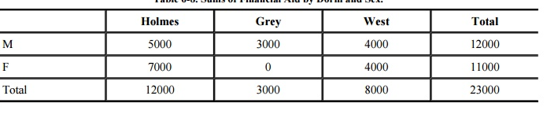
Indirect Attack
In the following sections, we present several examples of indirect attacks on databases that report statistics.
Sum
An attack by sum tries to infer a value from a reported sum. For example, with the sample database in Table, it might seem safe to report student aid total by sex and dorm. Such a report is shown in Table. This seemingly innocent report reveals that no female living in Grey is receiving financial aid. Thus, we can infer that any female living in Grey (such as Liu) is certainly not receiving financial aid. This approach often allows us to determine a negative result.

Slide 22
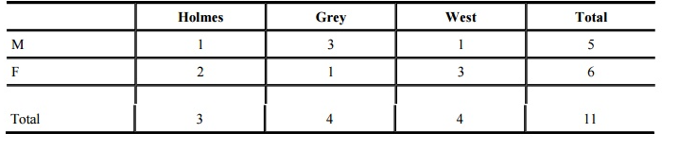
Cont…
Count
The count can be combined with the sum to produce some even more revealing results. Often these two statistics are released for a database to allow users to determine average values. (Conversely, if count and mean are released, sum can be deduced.)
Table 6-9 shows the count of records for students by dorm and sex. This table is innocuous by itself. Combined with the sum table, however, this table demonstrates that the two males in Holmes and West are receiving financial aid in the amount of $5000 and $4000, respectively. We can obtain the names by selecting the subschema of NAME, DORM, which is not sensitive because it delivers only low-security data on the entire database.

Slide 23
Cont…
Mean
The arithmetic mean (average) allows exact disclosure if the attacker can manipulate the subject population. As a trivial example, consider salary. Given the number of employees, the mean salary for a company and the mean salary of all employees except the president, it is easy to compute the president's salary.
Median
By a slightly more complicated process, we can determine an individual value from medians. The attack requires finding selections having one point of intersection that happens to be exactly in the middle,

Slide 24
Cont…
Tracker Attacks
A tracker attack can fool the database manager into locating the desired data by using additional queries that produce small results.
The tracker adds additional records to be retrieved for two different queries; the two sets of records cancel each other out, leaving only the statistic or data desired.
The approach is to use intelligent padding of two queries. In other words, instead of trying to identify a unique value, we request n - 1 other values (where there are n values in the database).
Given n and n - 1, we can easily compute the desired single element.

Slide 25
Summary
Importance of sensitive data & inference of data

Slide 26
Home Work
Q1. List down the types of attack in inference.

Slide 27
References
Text Books:
V. D. Dudeja ,”Cyber Crime and Law Enforcement”, Commonwealth Publishers, 2003.
C. Davis,”IT Auditing: Using Controls to protect Information Assets”, TMH, 2011.
Reference Books:
G.E. Kennedy & L.S.P. Prabhu, “Data Privacy Law: A Practical Guide”, Interstice; 2nd edition, 2017.
June M. Sullivan & Shannon B. Hartsfield, “HIPAA: A Practical Guide to the Privacy and Security of Health Data”, American Bar Association; 2nd edition, 2020.
Journals:
Pankaj Sharma, “Cyber Surveillance & Data Privacy Law: The Reconciliation”, https://www.researchgate.net/publication/335378068_Cyber_Surveillance_Data_Privacy_Law_The_Reconciliation?channel=doi&linkId=5d60da79a6fdccc32cccd626&showFulltext=true, 2019.
Online References:
MLDB Security Models: https://www.youtube.com/watch?v=47mVjXHng5Y
Know and protect your sensitive data: https://www.youtube.com/watch?v=gqmUVaG0JJs

Slide 28
THANK YOU
For queries
Email: merry.e12903@cumail.in

